Slide 1

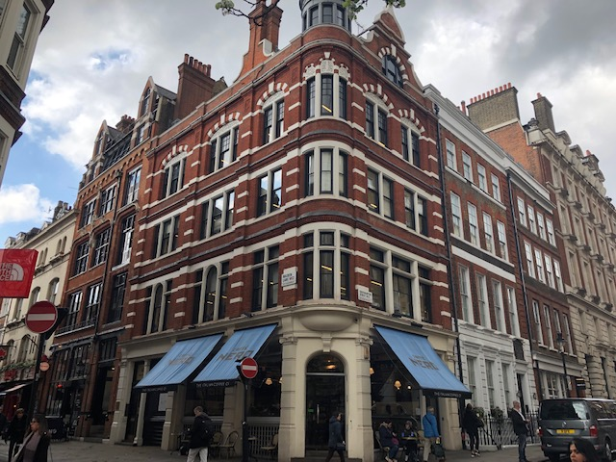
MODERN OFFICE IN THE HEART
OF COVENT GARDEN WC2
Tel: 07885 912 982
Insert an image here
44 Maiden Lane, Covent Garden
London, WC2E 7LN.
Approx. sq. 715ft. (66.4 sq. m)
Lease Assignment
Passing Rent - £49,490 per annum.

Slide 2
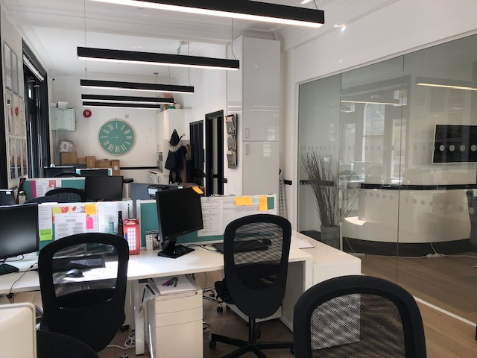
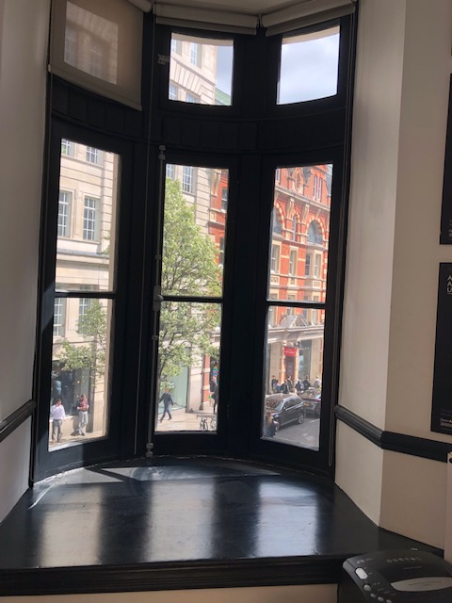
44, MAIDEN LANE WC2E 7LN.
Description
Arranged as a predominantly open plan office on the first floor forming part of a beautiful period building and benefitting from a corner position with wonderful views across Southampton Street. Excellent natural light throughout with every conceivable amenity on your doorstep.

Slide 3
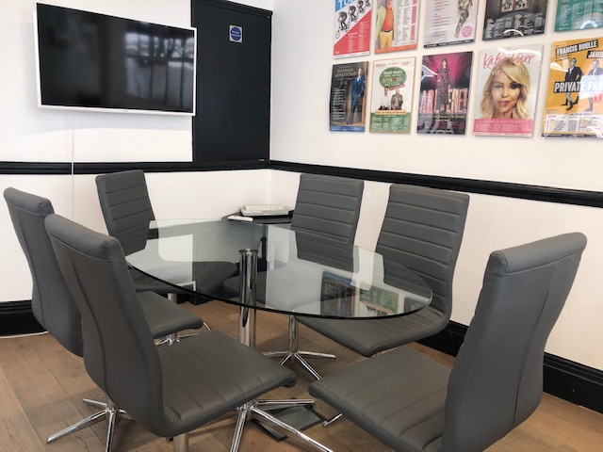
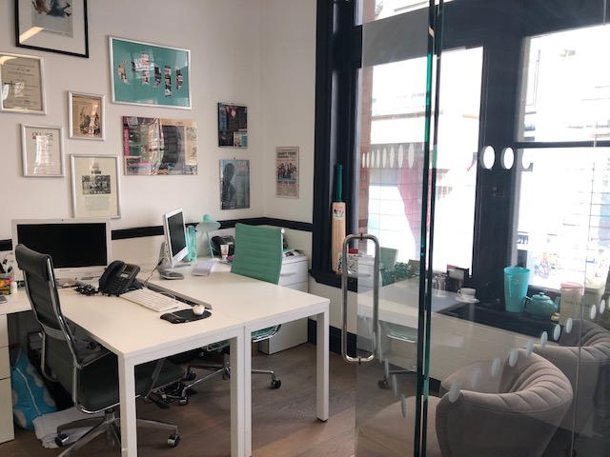
44 MAIDEN LANE, WC2E 7LN
MEETING ROOM
PRIVATE OFFICE

Slide 4
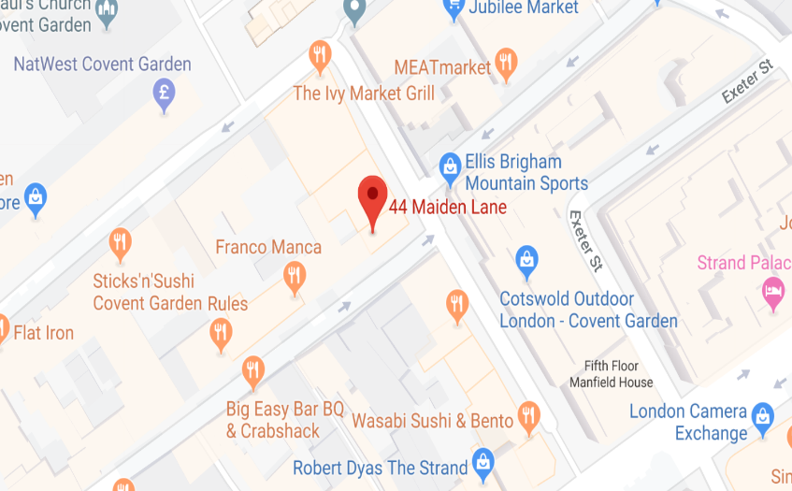
Tel: 07885 912 982
5 Risborough Street
EPC
EPC Rating = D - 82
Floor Area
712 sq ft (66.4 sq m)
Term
Lease Assignment for a term expiring 2nd November 2020 at a passing rent of £49,490 per annum exclusive of all outgoings. The lease is contracted outside the Landlord & Tenant Act 1954 and there are no further rent reviews.
Alternatively, the Landlord may consider offering a new lease subject to terms by arrangement.
Use
B1 (Business)
MAP
Service Charge
Approximately £10,800 per annum
Business Rates
The Rateable Value for 2019/20 is £31,250. therefore the business rates payable is approximately £15,000 per annum.
Location
The property sits on the north side of Maiden Lane close to the junction with Southampton Street. Covent Garden (Piccadilly line), Embankment (District, Circle & Northern lines) and Charing Cross mainline station is within walking distance.
There are a host of activities and venues to visit nearby including restaurants, bars, cafes and theatres in Covent Garden and The Strand.
Specifications
Wood flooring
Suspended lighting
Gas central heating
2 x meeting rooms
Open plan kitchen
Intercom
Security camera
Passenger lift
VAT
VAT is payable on the rent and service charge.
Further Details
Ian Lim
E: ian@limcommercial.com
Tel: 07885 912 982
MISREPRESENTATION ACT 1967
Important: These particulars have been prepared as agent for our clients and are intended as a convenient guide to supplement an inspection or survey. They do not constitute any part of an offer or contract and their accuracy is not guaranteed. They contain statements of opinion and in some instances we have relied on information provided by others. You should verify the particulars on your visit to the property and the particulars do not obviate the need for a full survey and all of the appropriate enquiries. Accordingly, there shall be no liability as a result of any error or omission in the particulars or any other information given.

